Slide 1
Wispr
Team Rocket William Holley, Jawad Usman, Lee Klarich, Sydney Mathis Adams

Slide 2
Build 2 Details
Updated UI for Login Page
New UI for Splash Page
Client/Server Connectivity
Error Handling for Login

Slide 3
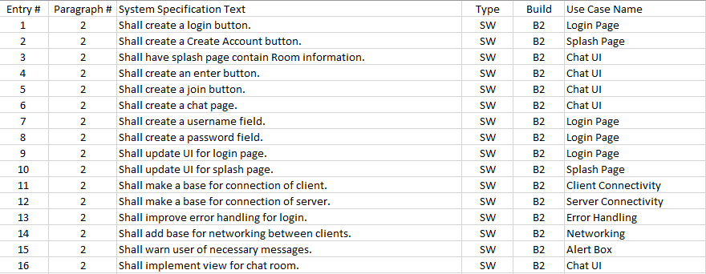
Updated RTM

Slide 4
User Guide

